Slide 1
Linear Algebra and Applications 16 September 2014
Lect. Erke ARIBAŞ
References:
-“College Algebra”, James Stewart, Lothar Redlin and Saleem Watson, 5th Edition, Cengage Learning, 5th Edition, 2008.
-“Linear Algebra Lecture Notes”, Assoc. Prof. Dr. Neslihan Serap Şengör, İTÜ

Slide 2
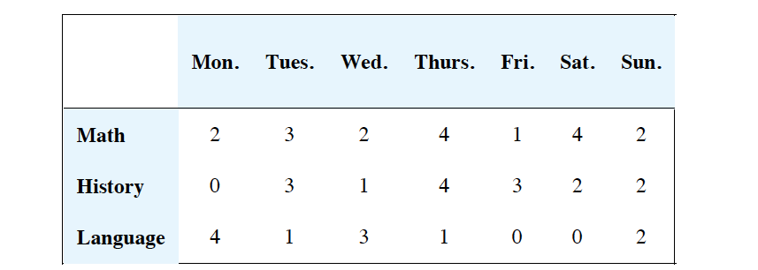
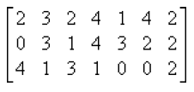
Matrices and Matrix Operations

Slide 3
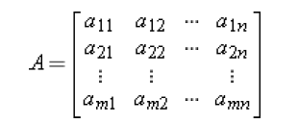


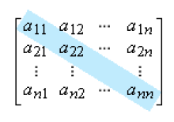

Main diagonal of A:

Slide 4

Equality of Matrices
If x=5, A=B
A and C are not equal since their sizes do not match.

Slide 5
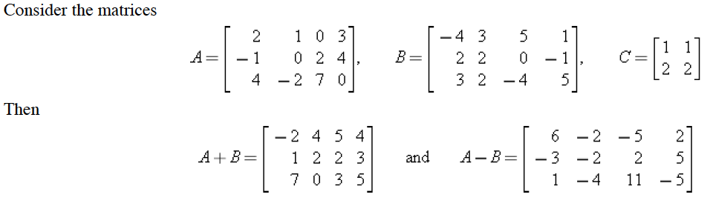

Addition and Substraction

Slide 6
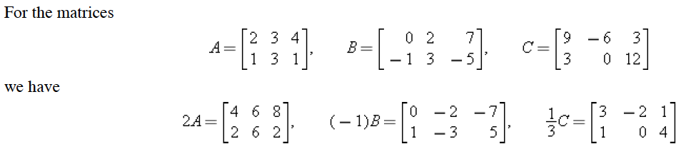
Scalar Multiples

Slide 7
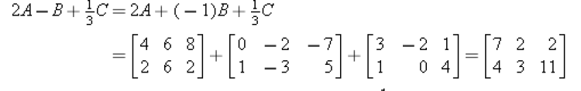

Slide 8
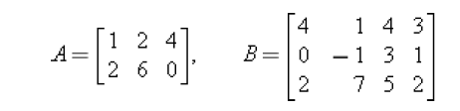
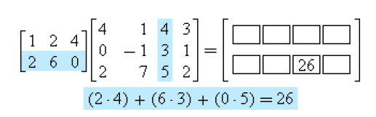
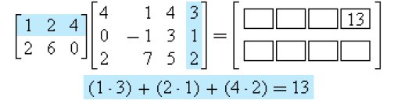
Matrix Multiplication

Slide 9
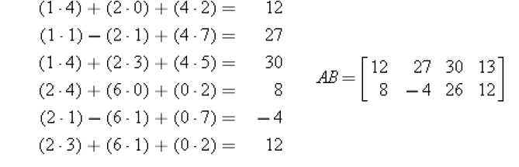
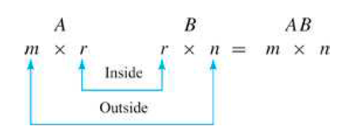

Slide 10

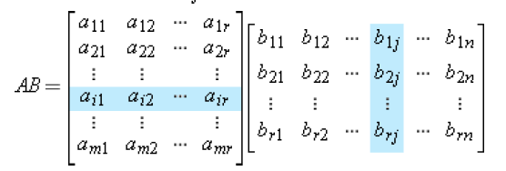

Determining whether a product is defined

Slide 11
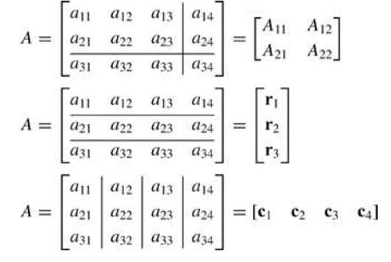
Partioned Matrices

Slide 12
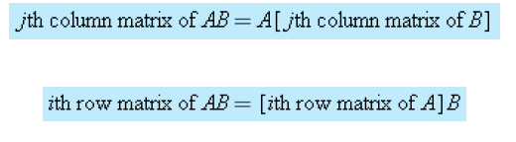
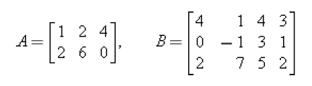
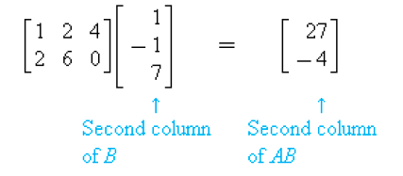
Matrix Multiplication by Columns and by rows

Slide 13


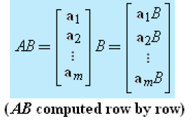

Slide 14
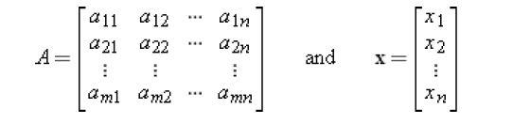
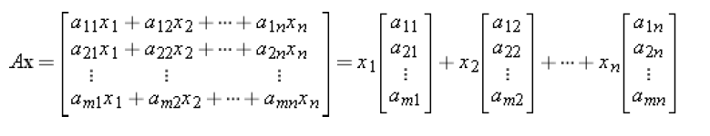
Matrix Products as Linear Combinations

Slide 15
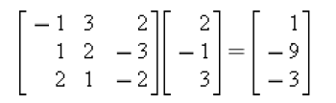
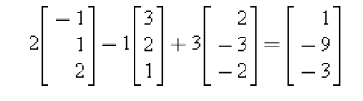
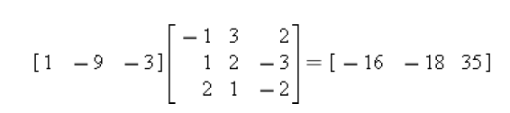
Linear Combination Example
Linear Combination of column matrices is:
Linear Combination of row matrices is:

Slide 16
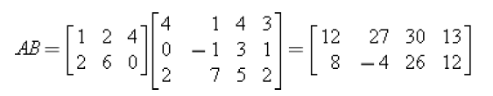
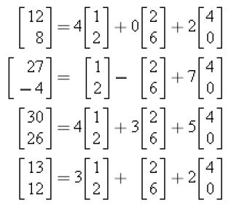
Linear Combination of column matrices of A is:

Slide 17
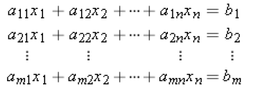
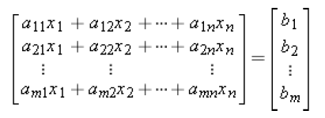
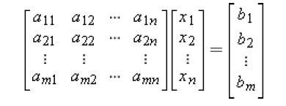

Matrix form of linear System

Slide 18
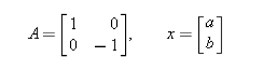





A function with matrices

Slide 19
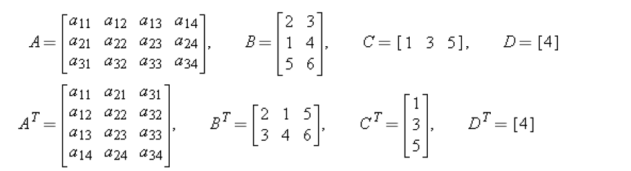
Transpose of a Matrix

Slide 20

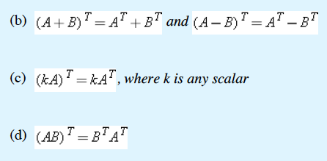

Properties of the transpose

Slide 21
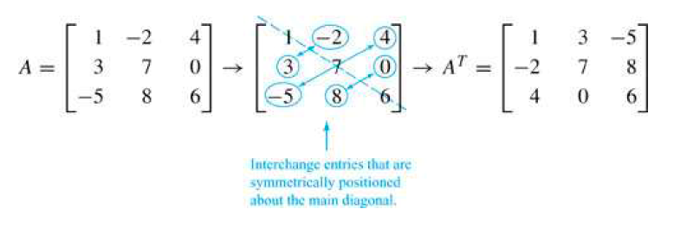
Transpose of a square matrix

Slide 22
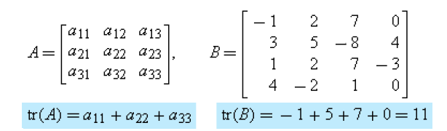
Trace of a Matrix

Slide 23
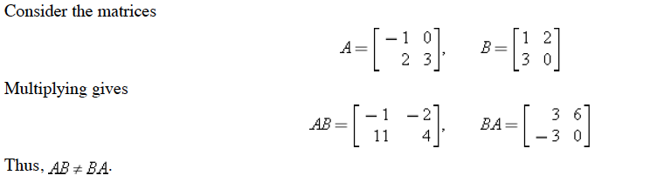
Inverses, Rules of Matrix Arithmetic

Slide 24
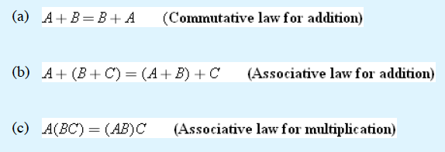
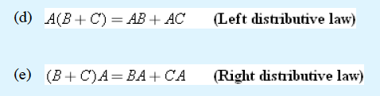
Properties of Matrix Arithmetic

Slide 25
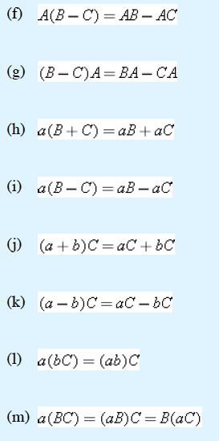

Slide 26

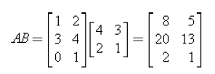

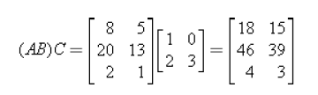
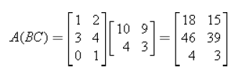
Associativity of Matrix Multiplication

Slide 27
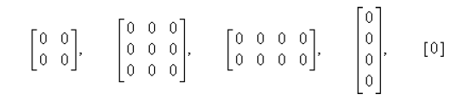
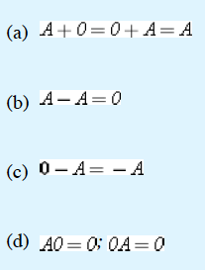
Zero Matrices

Slide 28
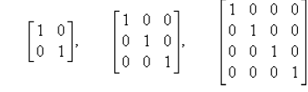
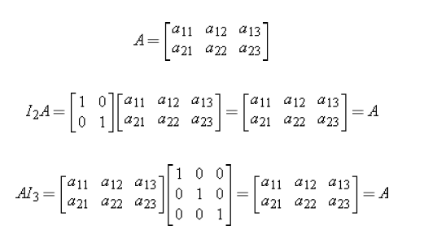
Identity Matrices

Slide 29
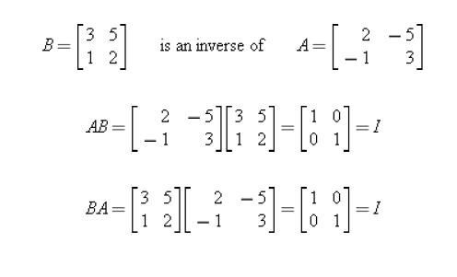
Verifying the Inverse Requirements

Slide 30
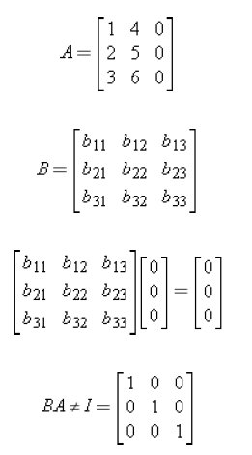
A matrix with no inverse

Slide 31


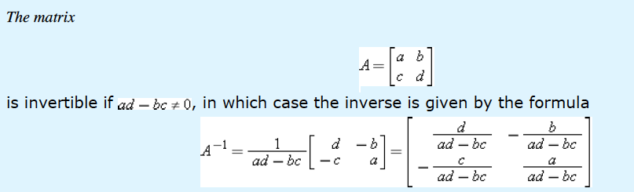
Theorem of Inverses

Slide 32
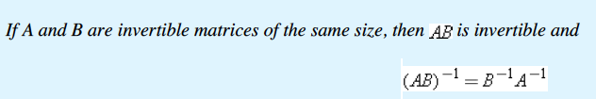

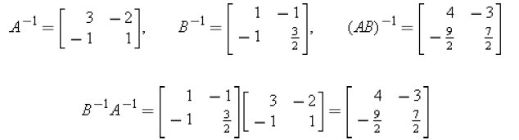
Theorem of Inverses

Slide 33
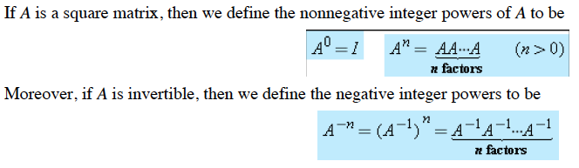
Powers of a Matrix

Slide 34


Law of Exponents

Slide 35

Power of a Matrix

Slide 36

Matrix Polynomial

Slide 37

Elementary Matrices and Row Operations

Slide 38



Slide 39


Slide 40


Using row operations to Find A⁻¹

Slide 41



Slide 42



Solving Linear system Using A⁻¹

Slide 43



Solving two linear systems at once

Slide 44




Determining Consistency by Elimination

